Slide 1


Where are we now?

Slide 2


Plan 21-24
Notes:
Since the promise was made in 2020, Scotland has had two overarching plans to keep the promise in practice: Plan 21-24 and now Plan 24-30.

Slide 3

A different kind of plan,
built on and for collaboration.
Notes:
Plan 24-30 is a shared planning framework for Scotland to keep the promise. It was designed to be different from a traditional strategy so it can update and change as circumstances change and progress is made. It is made up of 25 route maps and the Promise Story of Progress.

Slide 4
Plan 24-30 is made up of
25 Route Maps
organised under the
five foundations
of the promise.
The route maps provide clear milestones, commitments, and clear outcomes from now to
2030
Notes:
READ SLIDE, THEN
The 25 route maps are national level plans which build on progress and provide clear, timebound milestones, commitments and clear outcomes from now, to 2030.
Taken together, they cover all the conclusions of the Independent Care Review and make up Scotland’s shared planning framework to keep the promise.

Slide 5
Each route map has been updated to include:
what must be delivered for the promise to be kept,
who is responsible for doing it,
when it must be done, and
how route maps depend on each other for progress.
Notes:
The most recent update took place in December 2025 which included populating all 25 route maps, to include
READ THE SLIDE
Plan 24-30 and the route maps are not a substitute for organisational plans - instead by making clear destination statements, outcomes and milestones, it provides clarity on what actions are the responsibility of which organisations, by when.

Slide 6
Consolidated Outcomes
group the promise calls to action into coherent, delivery-focused clusters
are clear and measurable, which organisations can work to, and be held to account for delivering
provide the clarity needed on milestones (what), responsibilities (who) and sequencing (when)
captured exactly what must happen by 2030 for the promise to be kept
Notes:
In updating the route maps, work has been undertaken to support those working to keep the promise, to make delivery clearer. Across the themes there were calls to action, for where Scotland needs to be in 2030. This has translated the promise’s calls to action into clear, measurable outcomes with timebound milestones.
Importantly, every consolidated outcome statement is fully mapped back to the Independent Care Review and the promise’s calls to action, ensuring it stays true to what children, young people and care experienced adults said must happen.
They do not replace the original calls to action, but translate them into a format that support delivery, accountability and monitoring.

Slide 7
Updating
The route maps will continue to develop and adapt as Scotland progresses in keeping the promise, circumstances change, and work needs to focus or adapt.
Notes:
While Scotland now has a route, the route maps will not be static plans from here, and will continuously be developed, adapt and be added to as Scotland progresses in its journey to keeping the promise.

Slide 8
Many of the route maps are interdependent and require collaborative work to reach milestones.
Notes:
Sequencing:
Many of the route maps are interdependent and require collaborative work to reach milestones.
This means that for some route maps, they have a lot of commitments and milestones, while others have less information. This is because the route to achieve change in some areas, depends first on other changes being made.
A good example of this is the impact that the Children (Care, Care Experience and Services Planning) (Scotland) Bill will have.
Currently the Bill is going through a three-stage process to decide if it should become an Act (when it becomes a law).
This means the route maps focused on advocacy, profit in care, changes to the children’s hearings system and support for care experienced adults, are all subject to change, and the milestones and commitments will become clearer if/when the Bill becomes an Act.

Slide 9
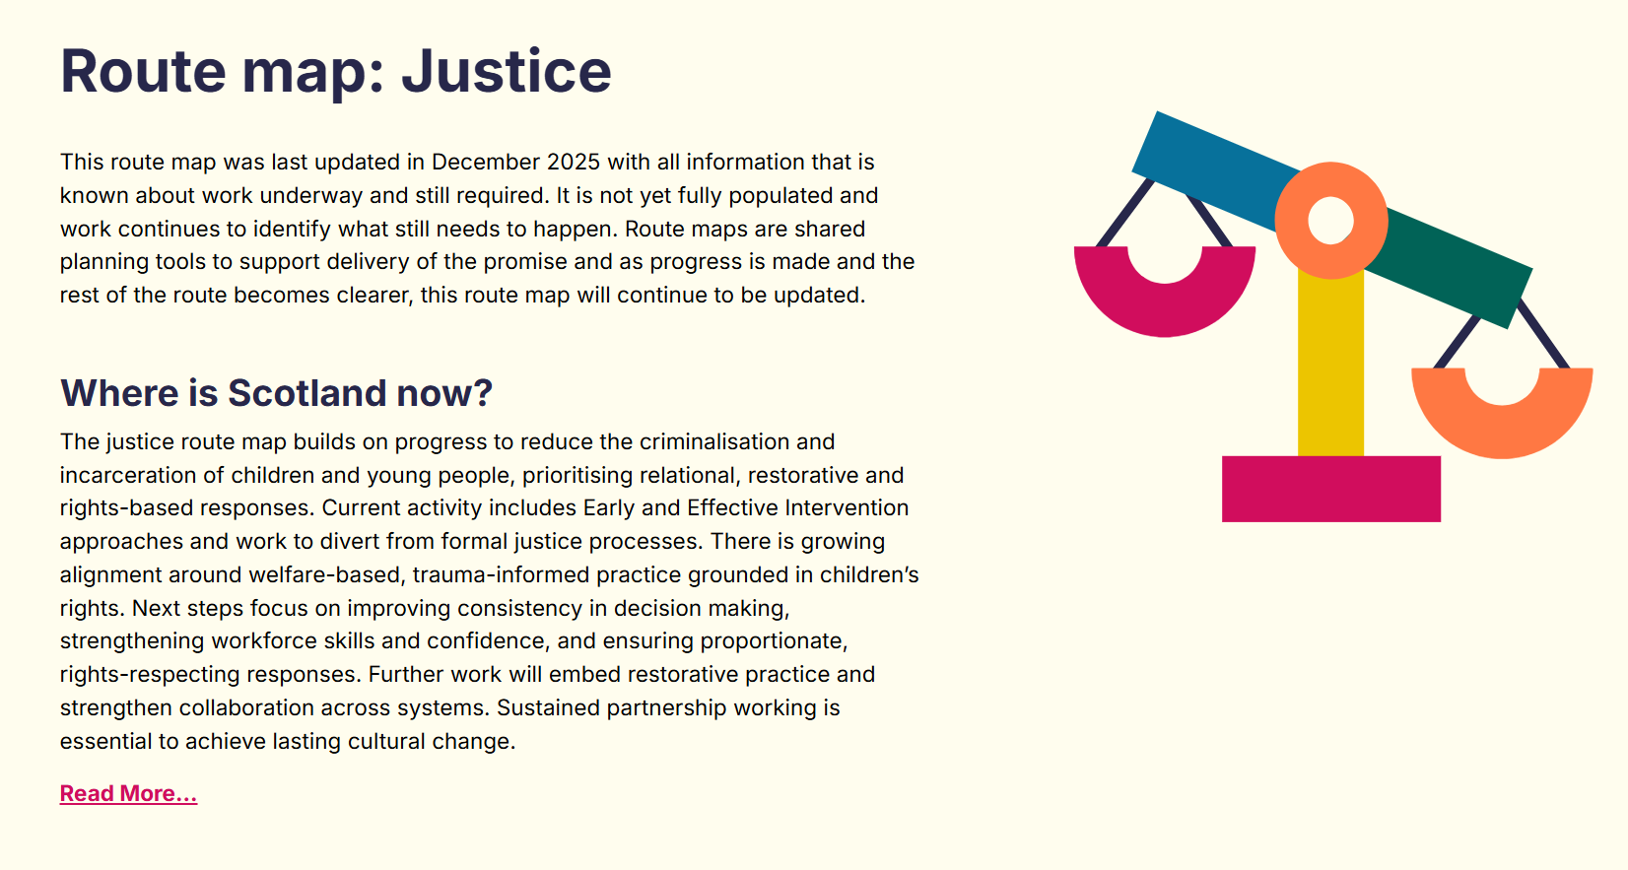

Notes:
Go through a route map example: Justice - Option 1
We'll now take a look at an example of one of the route maps: Justice.
The Justice route map builds on progress to reduce the criminalisation and incarceration of children and young people, prioritising relational, restorative and rights-based responses.
The outcomes in Justice are:
Children and young people are not criminalised or incarcerated. The response to behaviour is relational, restorative, and rights-based.
The justice workforce is supported and skilled to act relationally and trauma-informatively, replacing process-driven responses with understanding and care.
All children's court cases are heard in environments that uphold their rights and allow them to effectively participate rather than traditional criminal courts. Alternative approaches have been developed and more children are kept within the Children's Hearings System.
The minimum age of criminal responsibility is in line with the most progressive global governments.
No child is placed in a Young Offenders Institution or prison, and young people who turn 18 while in Secure Care are not automatically transferred to a Young Offenders Institute
You'll see that under each outcome there is work underway and milestones for the next years until 2030 and who is responsible for each. For example under the "Children and young people are not criminalised or incarcerated. The response to behaviour is rational, restorative, and rights based" outcome, in 2026 there is the completion of the renewed Early and Effective Intervention (EEI) guidance which is the responsibility of the EEI working group which commenced in 2025.
Not every year on every outcome has milestones yet. The route maps will be updated as progress is made in earlier years and more is known about where change is needed in the following years.
At the bottom of each route map is what matters to children, families, and care experienced adults which were developed from the testimony of the 5,500 people involved in the Independent Care Review and refined and organised to align with the themes of Plan 24-30. The result is a set of What Matters questions that stay closely connected to what the Independent Care Review heard and have been shaped through a careful and thorough process. There will be more on what matters questions shortly.
For the Justice route map, what matters is
"If I am in conflict with the law, I am treated as a child who is in need of love, support and safety, like any other child."
"If I have to be in contact with any part of the justice system, I can still thrive, my health, wellbeing and education are prioritised and my opportunities are not limited or negatively impacted by that contact."
"I am supported to overcome and longer-term impacts that being in conflict with the law has had on my life."

Slide 10
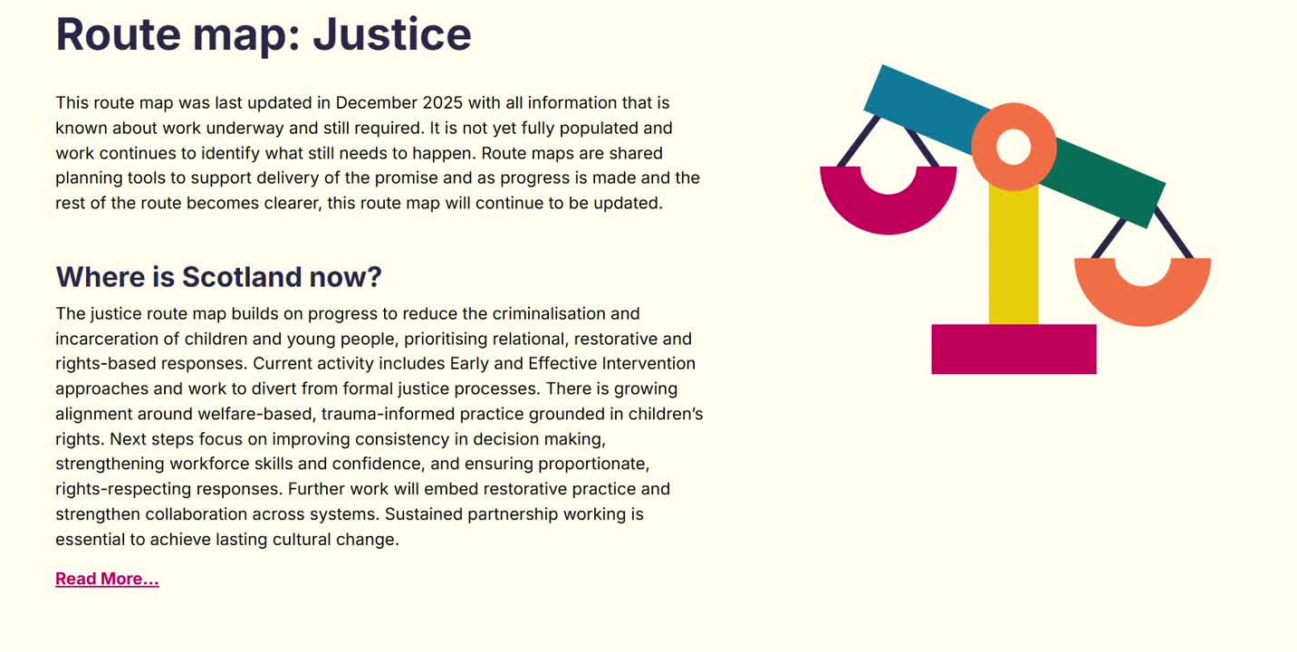
Notes:
Go through a route map example: Justice - Option 2
We'll now take a look at an example of one of the route maps: Justice.
The Justice route map builds on progress to reduce the criminalisation and incarceration of children and young people, prioritising relational, restorative and rights-based responses.
The outcomes in Justice are:
Children and young people are not criminalised or incarcerated. The response to behaviour is relational, restorative, and rights-based.
The justice workforce is supported and skilled to act relationally and trauma-informatively, replacing process-driven responses with understanding and care.
All children's court cases are heard in environments that uphold their rights and allow them to effectively participate rather than traditional criminal courts. Alternative approaches have been developed and more children are kept within the Children's Hearings System.
The minimum age of criminal responsibility is in line with the most progressive global governments.
No child is placed in a Young Offenders Institution or prison, and young people who turn 18 while in Secure Care are not automatically transferred to a Young Offenders Institute
You'll see that under each outcome there is work underway and milestones for the next years until 2030 and who is responsible for each. For example under the "Children and young people are not criminalised or incarcerated. The response to behaviour is rational, restorative, and rights based" outcome, in 2026 there is the completion of the renewed Early and Effective Intervention (EEI) guidance which is the responsibility of the EEI working group which commenced in 2025.
Not every year on every outcome has milestones yet. The route maps will be updated as progress is made in earlier years and more is known about where change is needed in the following years.
At the bottom of each route map is what matters to children, families, and care experienced adults which were developed from the testimony of the 5,500 people involved in the Independent Care Review and refined and organised to align with the themes of Plan 24-30. The result is a set of What Matters questions that stay closely connected to what the Independent Care Review heard and have been shaped through a careful and thorough process. There will be more on what matters questions shortly.
For the Justice route map, what matters is
"If I am in conflict with the law, I am treated as a child who is in need of love, support and safety, like any other child."
"If I have to be in contact with any part of the justice system, I can still thrive, my health, wellbeing and education are prioritised and my opportunities are not limited or negatively impacted by that contact."
"I am supported to overcome and longer-term impacts that being in conflict with the law has had on my life."

Slide 11
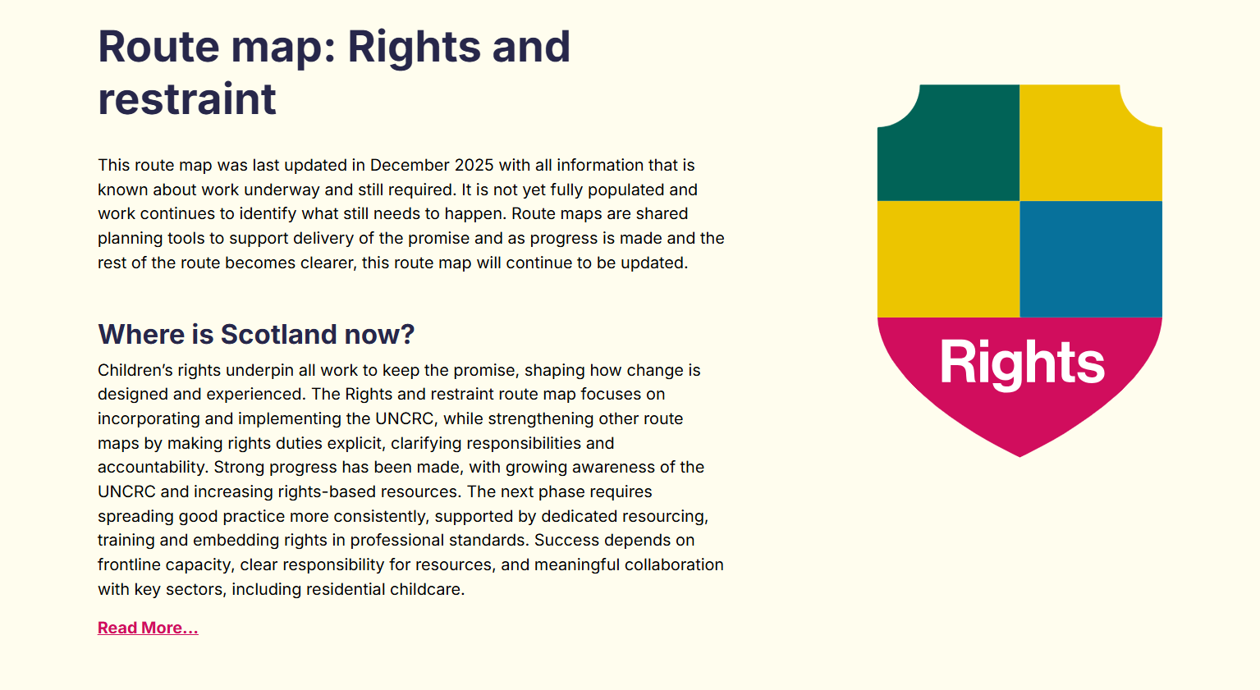

Notes:
Go through a route map example: Rights and Restraint – Option 1
We'll now take a look at an example of one of the route maps: Rights and Restraint.
The Rights and restraint route map focuses on incorporating and implementing the UNCRC, while strengthening other route maps by making rights duties explicit, clarifying responsibilities and accountability.
The outcomes in Rights and Restraint are:
Scotland fully upholds children and young people’s human rights. Every child, young person, and carer understands and can access their rights, which are taught, modelled and embedded across all settings. If children are moved from their families, their rights will be upheld as a minimum standard for their care.
Rights are upheld through relational practice rather than bureaucracy. Definitions of care experience and entitlements are inclusive and enduring, and systems address social and economic barriers that prevent nurturing care.
Scotland upholds children’s right to safety, dignity and relational support in all settings. Scotland is a nation that does not restrain its children unless in exceptional circumstances, and when it is unavoidable it is co-regulated, trauma-informed, lawful, recorded and used only to keep a child safe. The workforce are nurtured and supported, recognising their needs in this. Consistent definitions, safeguards and leadership cultures grounded in care and rights ensure restraint and seclusion is continuously reduced and monitored across all settings.
You'll see that under each outcome there is work underway and milestones for the next years until 2030 and who is responsible for each. For example, under the “Rights are upheld through relational practice rather than bureaucracy” outcome it states in 2026 Subject to Parliamentary scrutiny and passage the Children (Care, Care Experience and Services Planning) (Scotland) Bill will require Scottish Ministers to issue statutory guidance to improve how public authorities and others delivering public functions understand care experience and care-experienced people’s experiences, including promoting non-stigmatising language and best practice – with responsible bodies being Scottish Government, COSLA, Corporate Parents, Third Sector, Health Boards and Education
Further you’ll see that the Rights and Restraint route map is an example of collaborative and collective approach of Plan 24-30 which means working with partners including the Scottish Physical Restraint Action Group (SPRAG) to refine and develop the route map over 2026. The third outcome has been broken down into key areas including Education, Mental Health, Care, and All Settings to ensure progress and changes are understood across areas not siloed.
Not every year on every outcome has milestones yet. The route maps will be updated as progress is made in earlier years and more is known about where change is needed in the following years.
At the bottom of each route map is what matters to children, families, and care experienced adults which were developed from the testimony of the 5,500 people involved in the Independent Care Review and refined and organised to align with the themes of Plan 24-30. The result is a set of What Matters questions that stay closely connected to what the Independent Care Review heard and have been shaped through a careful and thorough process. There will be more on what matters questions shortly.
For the Rights and Restraint route map, what matters is:
“My rights are being upheld”
“I am supported to understand what my rights and entitlements are.”
“My rights are being remembered and prioritised in Scotland's laws.”
“I am nurtured and supported to explore and develop my identity and people who support me think about what my identity could mean for the help I might need at different times and places in my life.”
“I have got all the information I want about the things that impact me, I understand it, and I have chances to ask any questions and have them answered.
“If information about me is shared, it’s done sensitively, with respect and care for my feelings, for reasons I understand and have been explained to me.”
“l will never be physically restrained unless there is no other way to keep me safe.”
“If physical restraint is used on me, I will be given proper, caring support afterwards, by someone I trust, to deal with the impacts the experience has on me.”

Slide 12
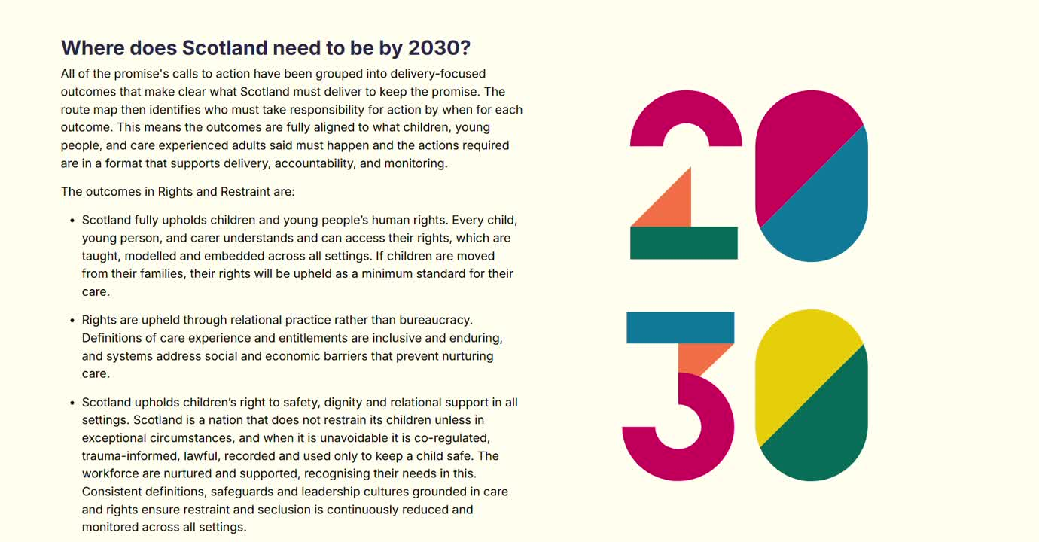
Notes:
Go through a route map example: Rights and Restraint – Option 2
We'll now take a look at an example of one of the route maps: Rights and Restraint.
The Rights and restraint route map focuses on incorporating and implementing the UNCRC, while strengthening other route maps by making rights duties explicit, clarifying responsibilities and accountability.
The outcomes in Rights and Restraint are:
Scotland fully upholds children and young people’s human rights. Every child, young person, and carer understands and can access their rights, which are taught, modelled and embedded across all settings. If children are moved from their families, their rights will be upheld as a minimum standard for their care.
Rights are upheld through relational practice rather than bureaucracy. Definitions of care experience and entitlements are inclusive and enduring, and systems address social and economic barriers that prevent nurturing care.
Scotland upholds children’s right to safety, dignity and relational support in all settings. Scotland is a nation that does not restrain its children unless in exceptional circumstances, and when it is unavoidable it is co-regulated, trauma-informed, lawful, recorded and used only to keep a child safe. The workforce are nurtured and supported, recognising their needs in this. Consistent definitions, safeguards and leadership cultures grounded in care and rights ensure restraint and seclusion is continuously reduced and monitored across all settings.
You'll see that under each outcome there is work underway and milestones for the next years until 2030 and who is responsible for each. For example, under the “Rights are upheld through relational practice rather than bureaucracy” outcome it states in 2026 Subject to Parliamentary scrutiny and passage the Children (Care, Care Experience and Services Planning) (Scotland) Bill will require Scottish Ministers to issue statutory guidance to improve how public authorities and others delivering public functions understand care experience and care-experienced people’s experiences, including promoting non-stigmatising language and best practice – with responsible bodies being Scottish Government, COSLA, Corporate Parents, Third Sector, Health Boards and Education
Further you’ll see that the Rights and Restraint route map is an example of collaborative and collective approach of Plan 24-30 which means working with partners including the Scottish Physical Restraint Action Group (SPRAG) to refine and develop the route map over 2026. The third outcome has been broken down into key areas including Education, Mental Health, Care, and All Settings to ensure progress and changes are understood across areas not siloed.
Not every year on every outcome has milestones yet. The route maps will be updated as progress is made in earlier years and more is known about where change is needed in the following years.
At the bottom of each route map is what matters to children, families, and care experienced adults which were developed from the testimony of the 5,500 people involved in the Independent Care Review and refined and organised to align with the themes of Plan 24-30. The result is a set of What Matters questions that stay closely connected to what the Independent Care Review heard and have been shaped through a careful and thorough process. There will be more on what matters questions shortly.
For the Rights and Restraint route map, what matters is:
“My rights are being upheld”
“I am supported to understand what my rights and entitlements are.”
“My rights are being remembered and prioritised in Scotland's laws.”
“I am nurtured and supported to explore and develop my identity and people who support me think about what my identity could mean for the help I might need at different times and places in my life.”
“I have got all the information I want about the things that impact me, I understand it, and I have chances to ask any questions and have them answered.
“If information about me is shared, it’s done sensitively, with respect and care for my feelings, for reasons I understand and have been explained to me.”
“l will never be physically restrained unless there is no other way to keep me safe.”
“If physical restraint is used on me, I will be given proper, caring support afterwards, by someone I trust, to deal with the impacts the experience has on me.”

Slide 13

The next stage of this work will be for The Promise Scotland to support organisations to take these national plans and turn them into local activity.
Bridging the national and
THE LOCAL
Notes:
The next stage of this work will be for The Promise Scotland to support organisations to take these national plans and turn them into local activity.

Slide 14
We want to hear from you:
Do the route maps start to set out the work required?
Are there inaccuracies, things that should be added, or concerns with the route maps?
How could you use them to guide your work and what help do you need?
Notes:
We want everyone working to keep the promise to spend the next month to use the website and review the updated route maps. The more everyone working to keep the promise engages with the route maps, by adding updating content, the better they will become.

Slide 15

Promise Story of Progress
Understanding how
change is happening and
where improvement is needed.
Notes:
The route maps show what needs to change, who will do it, and when but Scotland also needs a way to understand if these changes are making a real difference nationally, what the learning is from organisations when trying to implement changes, and how the commitments in the route maps are being felt by children, families, and care experienced adults.
The mechanism for understanding this is the Promise Story of Progress.

Slide 16


An agreed way of tracking progress
to make sure it’s felt in the lives and experiences of children, families, and the care experienced community
Notes:
The Promise Story of Progress aims to help Scotland to understand how change is happening and where improvement is needed.
It is an agreed way of tracking progress to make sure it's felt in the lives and experiences of children, families, and the care experienced community

Slide 17

by bringing together insights from three key questions:
How is Scotland doing in its progress towards keeping the promise?
How are organisations doing in their work to keep the promise?
Does the care community feel the impact of the promise being
kept?
Notes:
COSLA, The Scottish Government and The Promise Scotland are responsible for telling the Promise Story of Progress, which brings together different types of information to answer three questions:
How is Scotland doing in its progress towards keeping the promise?
How are organisations doing in their work to keep the promise?
Does the care community feel the impact of the promise being kept?

Slide 18










10 Vision Statements
Supporting children to stay with their families
Mental health and wellbeing
Carers and stability
Health
Education
Justice
Brothers and sisters
Aftercare
Support for care experienced adults
Physical restraint
Notes:
The information for the three questions of Promise Story of Progress is set out under ten vision statements, all of which were taken directly from the promise, and relate to areas of life that matter most to children, young people, care experienced adults and families. They show where change needs to be seen and measured.
The Promise Story of Progress is best understood by viewing all three parts together, by looking at the information for each question under each vision statement.
On their own, each of the three questions provides one part of the story. Seen together, they help to understand what is happening, how it is happening and most importantly how it’s being felt by the care community.
The website has links for users to navigate between the vision statements for each question.
The Vision Statements sit within and work alongside the 25 route maps in Plan 24-30. The insights from the Promise Story of Progress can then loop back to strengthen and focus the route maps, highlighting where more change is needed, and where the impact of the promise is being felt.

Slide 19

How is Scotland doing?
Uses quantitative data
Shows whether progress is being made at a national level, and what areas need greater focus.
Provides the scale and direction of change, alongside narrative to help readers to interpret these figures.
Notes:
Taking a closer look at each question
The national question pulls together multiple sources relevant to keeping the promise into one place. It:
· Uses quantitative data: statistics to track changes at the national level.
· Shows whether progress is being made at a national level, and what areas need greater focus.
· Provides the scale and direction of change, alongside narrative to help readers to interpret these figures.

Slide 20
How are organisations doing?
Focuses on how change happens in real settings. It focuses on learning to help to build understanding of what supports progress, and what gets in the way. This helps organisations adapt, innovate, and collaborate.
Notes:
Taking a closer look at each question
This brings together information that shows how organisations are making and sustaining change, what they are learning, and how they are improving practice.
It focuses on how change happens in real settings, helping to build understanding of what supports progress, and what gets in the way, helping organisations adapt, innovate, and collaborate.

Slide 21
Are the care community feeling the impact?
Reveals meaning, highlights gaps, and ensures that the care community’s perspective shapes how progress is judged and understood.
Notes:
Taking a closer look at each question
How change is being felt by the care experienced community sits at the heart of how to understand and measure success.
This question can’t measure progress on its own, but shows how Scotland’s progress is being felt by the care community. It reveals meaning, highlights gaps, and ensures that the care community’s perspective shapes how progress is judged and understood.
To begin to answer this question, The Promise Scotland used reports and outputs from advocacy bodies, third sector organisations, inspectorates, research centres and public agencies. These contained lived experience, participatory testimony, qualitative findings or reflective accounts that spoke directly to any of the Vision Statements.
In addition, Who Cares? Scotland and The Why Not? Trust provided targeted analysis of their existing evidence for this work.
This work aims to see if the data already held can help to answer the question, without placing extra burdens on the workforce in collecting data; or children, young people, care experienced adults and families in having to share more.
The next stage will be to see how to make this sustainable and build it into how Scotland collects and uses data.

Slide 22

How can the Promise Story of Progress help you?
Give context to your own data and learn how to make improvements, all while understanding how Scotland is doing
Check whether current practice is making a difference, understand what is working well, and see where change is still needed.
Notes:
When viewing the Promise Story of Progress, and bringing all these parts together, it’s important to remember that, following the conclusions of the Independent Care Review, Scotland made a national commitment to keep the promise in 2020, and we are all part of that national picture. There is a role for everyone to play ensuring the data and information in The Promise Story of Progress is being used to understand change, create change, and inform how this work continues.
The Promise Story of Progress will help practitioners, leaders and organisations by:
Bringing together national data, organisational learning and the impact felt by people with care experience to help users give context to their own data and learn how to make improvements, all while understanding how Scotland is doing.
Checking whether their current practice is making a difference, understand what is working well, and see where change is still needed. It supports learning rather than performance management and keeps the focus on what matters to children, young people, families and care experienced adults.

Slide 23


?
?
?
Asking the right questions
How would you answer this question?
How are you making sure that I am getting the support I need to overcome things that make it hard for me to participate, learn and thrive in education?
Notes:
The What Matters questions can help people to use the information from the Promise Story of Progress as a tool for learning, understanding and improvement.
The changes in national data can be seen alongside what organisations are learning and what lived experience is telling us, to give a more holistic picture of the bridges and barriers in all areas.
The What Matters questions can then help users explore what might be happening in their own setting, encouraging curiosity and reflection about what support might be needed and what might need to change.
For example:
“How are you making sure that I am getting the support I need to overcome things that make it hard for me to participate, learn and thrive in education?"
This helps organisations reflect on whether emotional or practical barriers are being understood and removed, so that school feels accessible and attendance is supported.
Insights from the Promise Story of Progress and what matters questions can loop back to strengthen and focus the route maps, highlighting where more change is needed, and where the impact of the promise is being felt creating an accurate and full picture of progress and barriers to change.

Slide 24


Recap:
How it all fits together
Plan 24–30: Scotland’s shared planning framework to keep the promise by 2030
Route Maps: Show what needs to change, who must act and when
Promise Story of Progress: Helps us understand whether change is being felt and is making a difference
Notes:
Designed to work together, not in isolation.​ Taken together, the route maps show what must be done and the Promise Story of Progress provides learning on how it can be done, and if the changes are having an impact.

Slide 25
Feedback:
Do the route maps start to set out the work required?
Are there inaccuracies, things that should be added, or concerns with the route maps?
How could you use them to guide your work and what help do you need?
Notes:
The more everyone working to keep the promise engages with the route maps, by adding updating content, the better and more effective they will become.
Start by answering the questions
Do the route maps start to set out the work required?
Are there inaccuracies, things that should be added, or concerns with the route maps?
How could you use them to guide your work and what help do you need?
After the initial feedback period, in 2026 The Promise Scotland will be working on supporting organisations to take these route maps, and translate them into their own plans to keep the promise by 2030.

Slide 26
Local Context:
How are we using the route maps and the Promise Story of Progress to align, accelerate, and evaluate progress to keep the promise in your area
Notes:
The route maps are a national shared planning framework for keeping the promise, built on and for collaboration. They are not a substitute for organisational plans— instead, by making clear destination statements, outcomes and milestones, they provide clarity on what actions are the responsibility of which organisations, by when.
We are working on translating this national picture into local delivery by understanding what enables progress or is a barrier that needs addressed in our area and feeding that back into the national picture.

Slide 27

Local examples:
Example 1
Example 2
Example 3
Notes:
Blank slide for adding local context

Slide 28

Find out more at plan2030.scot and provide feedback to plan2430@thepromise.scot

