Slide 2
Notes:
The scene begins (top left) with the foundation icon for Voice.
The position of the voice icon is one that influences the entire scene and wraps round all other foundations of the promise. This foundation is about ensuring the voice of children, young people, their families, and care experienced adults is prioritised.
Bottom left begins the start of the route map to 2030, the journey Scotland must take to keep the promise using Plan 24-30.
The stairs to the start of the route map are beside elements that are what has come before, and work that will continue to be built on - books for research and learning, and ears for listening.
Supporting the route are the things that need to be in place for work to keep the promise to progress - coins for financing, data, the sector icons representing those who need to work and change, the lightbulb for ideas and innovation, the apple and pencil for continuous learning.
Scaffolding is everything that must support Plan 24-30 (adjacent systems) and the crane is the collective effort of building. The crane itself is in the background to symbolise there is much more work to be done and it is in progress.
All foundation icons are on platforms elevated as they are imperative to the plan, with corresponding colours for each foundation. The saltire flag gives context to where the plan is taking place, as well as signs on the road laying out the route map.
The figures in the illustration give context to who the plan is for. With a ratio of 2:1, adults make up 2/3 of the people in the scene. Those in the scene are the ones who need to act the most to make the plan work. Each age group is represented, with interactions between them showing collaboration (waving), led by children (hand holding) etc. Finally, the bottom half of the image is more populated than the top to show more is known for the first few years and the rest will become clearer and busier as progress is made.

Slide 3
What is Plan 24-30?
Meeting in the middle
The five foundations and the route map
Who must act?
Understanding progress

Slide 4
What is Plan 24-30?
“To make the promise a reality a radical new approach to design and implementation is required.” the plan, page 2
Static destination: Plan 24-30 sets out what must change, by when and who must act. This is the static destination; the promise must be kept by 2030.
Dynamic route-map: The route map to 2030 will be dynamic. Keeping the promise requires joined-up working and agile delivery to respond to both expected and unexpected changes. The destination is known, but the path to change will evolve as progress is made to 2030.

Slide 5
Plan 24-30 is Scotland’s route map to #KeepThePromise
It is organised around the five foundations of the promise: voice, family, care, people, and scaffolding.
All the conclusions of the Independent Care Review have been organised and grouped under these foundations in a way that makes sense for the work still required.

Slide 6
Meeting in the middle
Plan 24-30 makes the challenges and opportunities of wider service reform visible in the ‘Meeting in the middle’ diagram. For the promise to be kept, change is needed far beyond the traditional ‘care system’:
People don’t live in parts of systems; they need access to different public services and systems across their lives.
The ‘care system' relates to, and is dependent on, other systems and structures.
The Meeting in the middle diagram demonstrates the key areas where reform is needed. Each area acts as both an enabler and a barrier to the promise being kept.

Slide 7
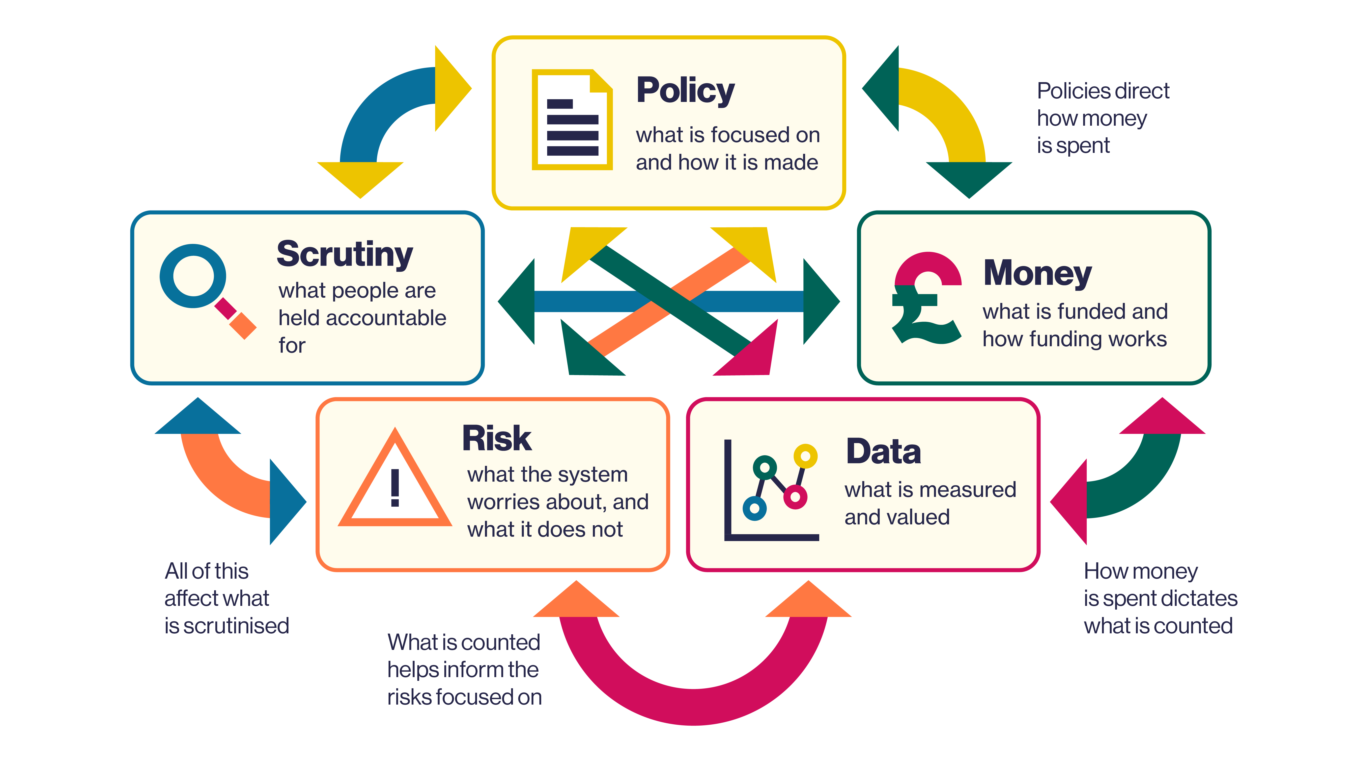
Meeting in the middle

Slide 8
Plan 24-30 is organised around the five foundations of the promise
Voice
Family
Care
People
Scaffolding

Slide 9
VOICE
FAMILY
CARE
PEOPLE
SCAFFOLDING
Participation / Engagement
Listening
Documenting decisions
Poverty
Universal family support
Intensive family support
Decision making
Advocacy
Relationships
Stability
Where children live
Moving on/ lifelong support
Leadership
Recruitment / retention
Rules, processes / culture
Workforce support
Rights
Data / information
Money / commissioning
Legislation
Scrutiny / inspection
Governance
Education
Justice
Health

Slide 10
Voice
When the promise is kept, the voices of children, young people and care experienced adults will always be heard and no decision will be taken about their lives without clear, documented evidence of views being taken into account.
Themes in voice
Documenting decisions
Listening
Participation and engagement
www.plan2430.scot/voice/

Slide 11
Family
When the promise is kept, families will be properly supported to ensure their children can stay at home wherever it is safe to do so, and all options to keep families together will have been exhausted before any decisions are made about going into care. Where children cannot stay with their families, families will continue to be supported to ensure they can keep in touch and have all they need.
Themes in family:
Universal family support
Intensive family support
Poverty
www.plan2430.scot/family/

Slide 12
Care
When the promise is kept, the relationships that are important to children will not be affected by their experience of care and they can keep in touch wherever it is safe to do so. When children move on from care, the support they have will not end.
Themes in Care
Advocacy and legal advice
Decision making
Moving on and lifelong support
Relationships
Stability
Where children live
www.plan2430.scot/care/

Slide 13
People
When the promise is kept, people across the workforce will have the support and skills they need to do what is required of them in their day-to-day jobs and will be able to build relationships and make decisions based on listening and compassion.
Themes in People
Leadership
Recruitment and retention
Rules, processes and culture
Workforce support
www.plan2430.scot/people/

Slide 14
Scaffolding
This foundation is about the ways in which the 'care system' relates to, and is dependent on, other systems and structures that although may be considered as separate, often have a significant impact on lives. When the promise is kept, care experienced children and adults will be people first and foremost and will not have to be defined by their care experience in every service and support they have.
Themes in scaffolding
Data and information
Education
Governance
Health
Justice
Legislation
Money and commissioning
Rights
Scrutiny and inspection
www.plan2430.scot/scaffolding/

Slide 15
For each theme:
Where is Scotland in 2024?
Where does Scotland need to be by 2030?
The route map to get there
Focus on
2024, 2025, 2026, 2027, 2028, 2029, 2030
What is helping?
Who must act?
Understanding progress
Also connected to this theme

Slide 16
Where does Scotland need to be by 2030?
Each theme sets out what Scotland must have in place for the promise to be kept to care experienced children, young people and adults. What needs to happen is the static destination to keep the promise by 2030. It incorporates the calls to actions from the independent care review. Details on how Scotland will get there are set out in the route map, which is dynamic and will evolve as progress is made.

Slide 17
Focus on
Each of the five foundations has a ‘focus on’ area which states a particular challenge that needs a collective response and where change must be accelerated to ensure the promise is kept.
Voice - focus on accurate record keeping that can evidence views were sought and informed decision making. When documenting decisions, the right to access care records must be respected.
Family - focus on very young children and babies. Scotland must support families at an earlier stage, so more babies and infants remain at home in loving nurturing relationships.

Slide 18
Focus on
Care - focus must be on unaccompanied asylum-seeking children and young people, as the number entering Scotland’s ‘care system’ has meant that an already stretched system is not well equipped to meet their needs.
People - focus must be on the crisis on the workforce in and around Scotland’s ‘care system’; there are simply not enough people in the system to do the work required to care and support, let alone reform.
Scaffolding - focus must be on ensuring that funding is clearly aligned to need and impact across the 'care system' and all adjacent systems.

Slide 19
The route map to get there
2024
2025
Plan 24-30 provides a single shared route map for Scotland. It maps what needs to happen by when, and by who. For some of the themes, the milestones are already mapped out and progress is underway. For others, the route to 2030 may be less clear, it could be dependent on progress in another area or different sectors coming together to reach a consensus on what action should be taken.
This part of Plan 24-30 is dynamic and will evolve to reflect progress made over time. Details on how Plan 24-30 will evolve and how organisations will be invited to contribute will be shared in the autumn.

Slide 20
What is helping?
This section of the Plan outlines the factors driving progress. It highlights the bridges underpinning and facilitating change, such as:
funding,
policy and legislative developments,
partnership working,
research.

Slide 21
Who must act?
Justice
Housing
Improvement
Scottish Government
Health
Public Bodies
Voluntary Sector
Local Government
Education
Scrutiny

Slide 22
Understanding Progress
All the activity and progress made across organisations, sectors and communities to keep the promise must be understood.
Three key questions underpin the Promise Story of Progress:
How is Scotland doing in its progress to #KeepThePromise?
How are specific organisations doing in their work to #KeepThePromise?
Does the care community feel the impact of the promise being kept?
These questions provide a starting point to monitor, scrutinise and understand whether the promise is on track to be kept.

Slide 23
Understanding Progress – The Promise Progress Framework
Developed by COSLA, the Scottish Government and The Promise Scotland to answer the question ‘how is Scotland doing in its progress to #KeepThePromise?’.
The Promise Progress Framework:
Uses multiple existing data sets to build an understanding of national progress
Will be openly available to support collective understanding and accountability.
Will align with relevant frameworks e.g. National Performance Framework
Will be live by end of 2024.
Understanding Progress – Plan 24-30

Slide 24
Understanding Progress – The What Matters Questions
The ‘What Matters’ questions were created from what children and families told the Independent Care Review about what was important to them.
They have been mapped to Plan 24-30 to ensure progress is understood from the perspective of what matters to children, families and care-experienced adults.
The ‘What Matters’ question cards are designed to be a tool to support improvement and understanding.
‘What Matters’ Question cards – Plan 24-30

Slide 25
Discussion questions
What are the bridges and barriers to progress?
Are these reflected in Plan 24-30?
What are the enabling conditions that will allow you/your organisation to keep the promise?
What is your/your organisation’s role in keeping the promise and contributing to Plan 24-30?
Who do you need to work with?
What tools, resources or support would help?

Slide 26
plan2430@thepromise.scot

